Slide 1
Schedule Planner
Build • Compare • Share — Fall 2026 student tool

Slide 2
Fall 2026 Planner
Fall 2026 Planner is a premium, student-built web app for creating Fall term schedules. Build • Compare • Share. STUDENT-BUILT. A smarter way to build, compare, and share university schedules. Leave space for a live screenshot, URL, and QR code.

Slide 3
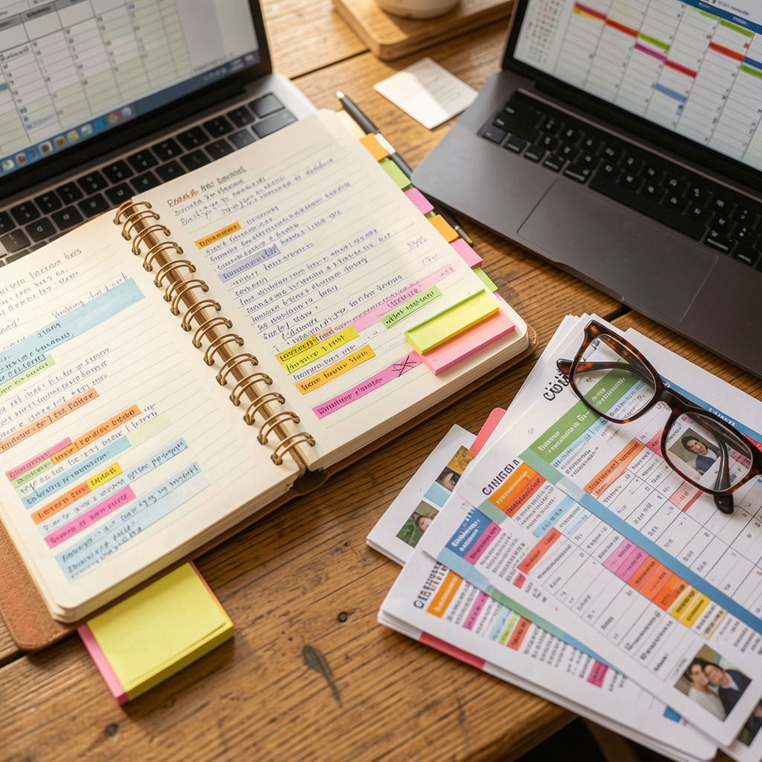
Fragmented Scheduling
Students juggle dozens of lecture, lab, and tutorial options, creating hundreds of possible combinations. Conflicts appear frequently, and comparing sections or instructors is slow and error-prone. Cross-year courses are hard to browse, while manual planning requires repeated checks across pages and calendars.

Slide 4
Unified Planner
01
02
03
Choose Major/Year
Pick Courses
System Validates
Set your program context to tailor course options.
Select courses and sections (lectures, labs, tutorials, instructors).
The planner disables invalid combos in real time.

Slide 5
Workflow Flow
Major & Year
Browse Courses
Pick Sections
Detect Conflicts
Set Preferences
Build & Share
Choose your degree program and current year to tailor the catalog.
Explore with filters and find compatible courses.
Select meeting times and sections that fit your plan.
The planner flags overlaps before you proceed.
Prioritize work, lab, or elective goals to influence suggestions.
Generate a shareable schedule link for advisors or teammates.

Slide 6
Conflicts Detected Automatically
overlaps may go unnoticed until later. Timetables aren’t protected, so you might pick conflicting slots and only learn after you try to save. Visual cues are absent or scattered, making it easy to overlook a clash.
The timetable highlights overlaps in real time. Conflicting options are disabled with a tooltip that explains why (e.g., 'Lab overlaps with Lecture A: Mon 10:00–12:00'). See the before/after: manual planning vs. planner’s protected choices.
Overlaps are detected and explained or disabled in real time.

Slide 7
Cross-Year Browsing
Students can explore courses from Year 1 through Year 4 in a single browse. The system surfaces electives and prerequisites across years, so you can compare options without switching majors. Shared requirements—like English and SCH electives—remain visible and enforceable, no matter your year or major.

Slide 8
Best Schedule
Access the preference panel to tailor your planning rules.
Open Preferences
Adjust max hours per day, preferred free day, gap minimization, earliest finish, latest start, and credit limits.
Set Constraints
Run the generator to produce multiple valid schedules that honor your preferences.
Generate Alternatives
Preview several schedules and compare against your constraints before selecting.
Review Options

Slide 9
Personalize & Generate
Set Preferences
Run Generator
Review Options
Students input max hours per day, preferred free day, min gaps, earliest finish, latest start, and credit targets (13/18/21).
Best Schedule Generator creates multiple valid options that honor every constraint.
See several complete schedules with different free days, gaps, and finish times. Toggle complete schedule to include all courses.
Select & Save
Choose the top schedules, save preferred ones, or export for sharing with peers.

Slide 10
No Gaps, Fast Finish
Schedule 1
Schedule 2
Free days: 2. Total gaps: 3. Credits: 15. Daily workload: moderate. Use This Schedule to see a balanced week with two free days.
Free days: 0. Total gaps: 1. Credits: 15. Daily workload: compact; finish by 3:45 PM. Use This Schedule to minimize interruptions and finish early.
Zero gaps and earliest finish is the standout option.

Slide 11
Shareable Schedule
01
02
03
Generate Link
Share Link
Open & Reproduce
Student A creates a URL or QR code that encodes their selected courses, sections, and preferences.
The link or QR is shared with peers for quick access.
Student B opens the link to see the exact same schedule instantly.

Slide 12
Mobile-first Timetable, Clear on Every屏
Dense timetable with full feature set, multi-filter options, and cross-year browsing. Ideal on larger screens, where precise selections and expansive controls are the focus.
Touch-first layout with large targets, single-column timetable, and readable typography. Quick course search, instructor filters, and reset controls optimized for one-handed use.
Mobile view preserves readability and usability on phones without sacrificing core functionality.

Slide 13
Plan With Purpose
Fall 2026 Planner lets you build your schedule, generate alternatives tailored to your preferences, and share one link with classmates or advisors. Mobile-friendly, collaboration-ready, and easy to review at a glance. Turn tentative plans into a trusted syllabus for the semester.

Slide 14
Thanks
Do you have any questions?
your email@freepik.com
+91 620 421 838 yourcompany.com
Please keep this slide for attribution

